Slide 1
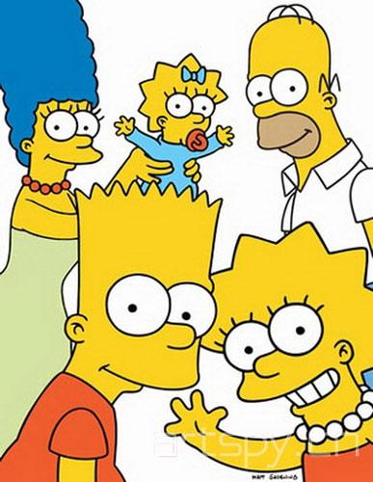
Image Detection of Simpson’s Characters
George Mason University
DAEN 690
Summer 2019
Manju Prasad
Ravi Rane
Yinchen Niu
Zegang Liu
Tad Berkery

Slide 2

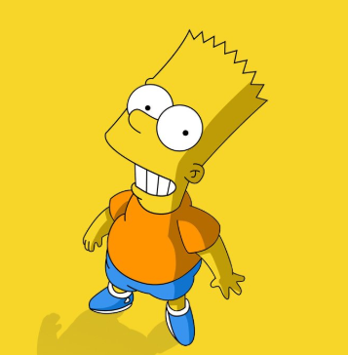
Roles of Teammembers
Team Roles:
Product Owner – Ravi Rane
Scrum Master – Manju Prasad
Developer – Yinchen Niu
Developer – Zegang Liu
Developer – Tad Berkery

Slide 3

Introduction
Object detection and image classification are at the forefront of computer vision technologies found throughout society today. Recent advancements in facial-detection-based surveillance in the security industry, pedestrian and sign detection in self-driving cars, and automated valuation of properties are all applications of this cutting-edge technology.
We want to:
Classify Simpson characters from images and from videos
Extend this functionality when we have multiple characters in an image.
Be able to recognize each individual character and draw bounding box around each
Have good interface to perform the classification

Slide 4
Project Description
Utilizing the popular 30-season show The Simpsons, this project implements object detection and image classification for primary characters from the Simpsons series.
Various deep learning architectures:
Convolutional Neural Network (CNN)
Faster Region-based Convolutional Neural Network (R-CNN)
You Only Look Once (YOLO)
Single Shot Multi-box Detection (SSD)

Slide 5
Project Description
As a secondary focus, this project implements YOLO to videos and explores the use of cloud computing to train and execute models. Visualizations and a User Interface (UI) that enable a real-time data feed to model execution are also implemented to encourage further use of our findings.

Slide 6
Why We Chose This Project?
We want to classify Simpson characters from images and from videos. We also want to extend this functionality when we have multiple characters in an image. We should be able to recognize each individual character and draw bounding box around each. We need to have good interface to perform the classification.
Simpson is a very popular cartoon and our team was interested in working on an image analytics related project. On seeing the Kaggle dataset related to image detection of Simpson’s characters (as proposed in the Suggested Projects by our Professor), our team decided to work on this.

Slide 7

About Data
License CC BY-NC-SA 4.0 (Creative Commons License)
(Who)
Agent
Data set was downloaded from Kaggle.com
(How)
Dataset has grown since it was initiated because author has added new images over a period of time.
(What)
Interest in image analytics, deep learning.
(Why)
Cause
Reason
Location
Time
In Kaggle.com
(Where)
Simson’s seasons 4-24
(When)

Slide 8
About Data
The image dataset available on Kaggle.com has 20 folders (one for each Simpson character) with 400-2000 pictures in each folder.
This image dataset is a collection of video frame captures from Simpson’s episodes. Dataset includes images that feature multiple characters in a single frame.
There may be insufficient images with multiple characters for tagging. This may require the team to generate additional frames with multiple characters.
File descriptions and explanations:
File simpson-set.tar.gz : This is an image dataset: 20 folders (one for each character) with 400-2000 pictures in each folder.
File annotation.txt : Annotation file for bounding boxes for each character

Slide 9
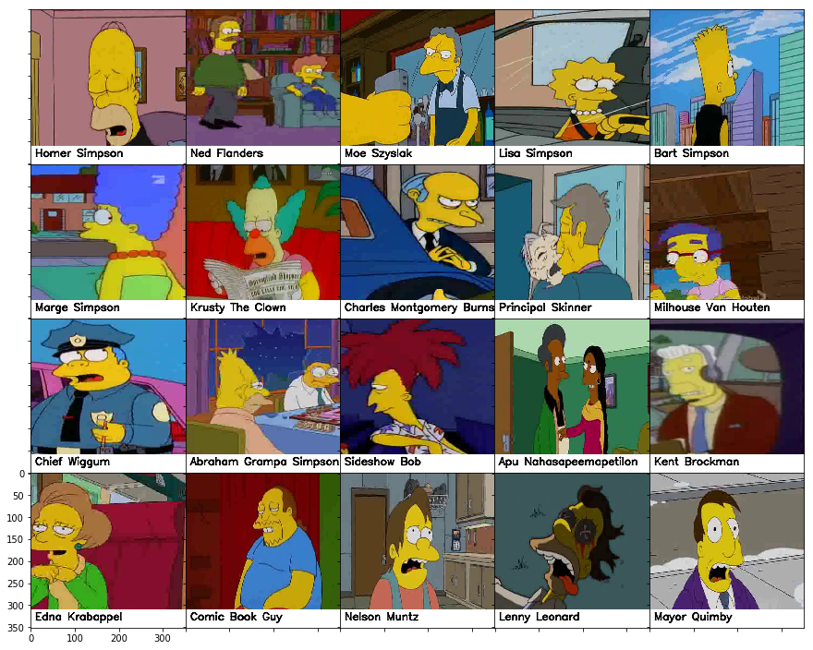
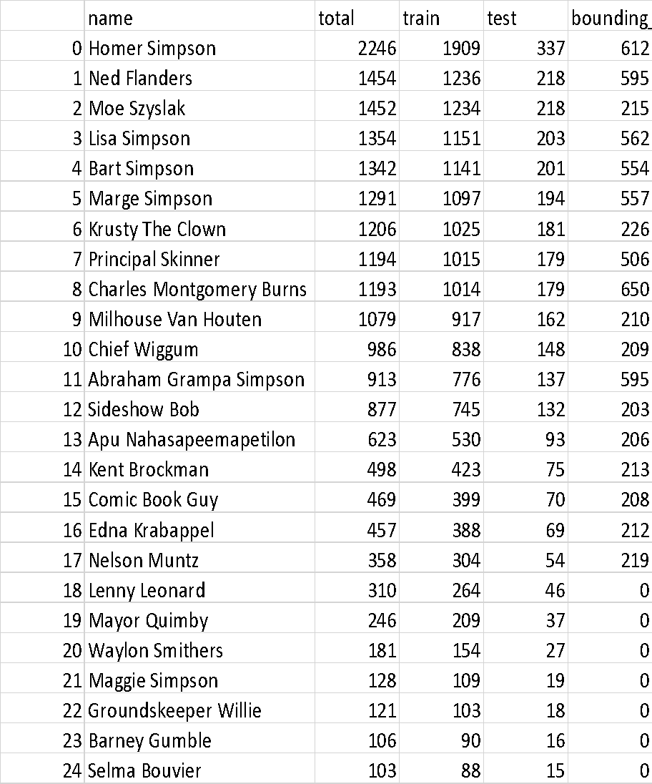
About Data
Table showing all characters with over 100 images in the dataset

Slide 10
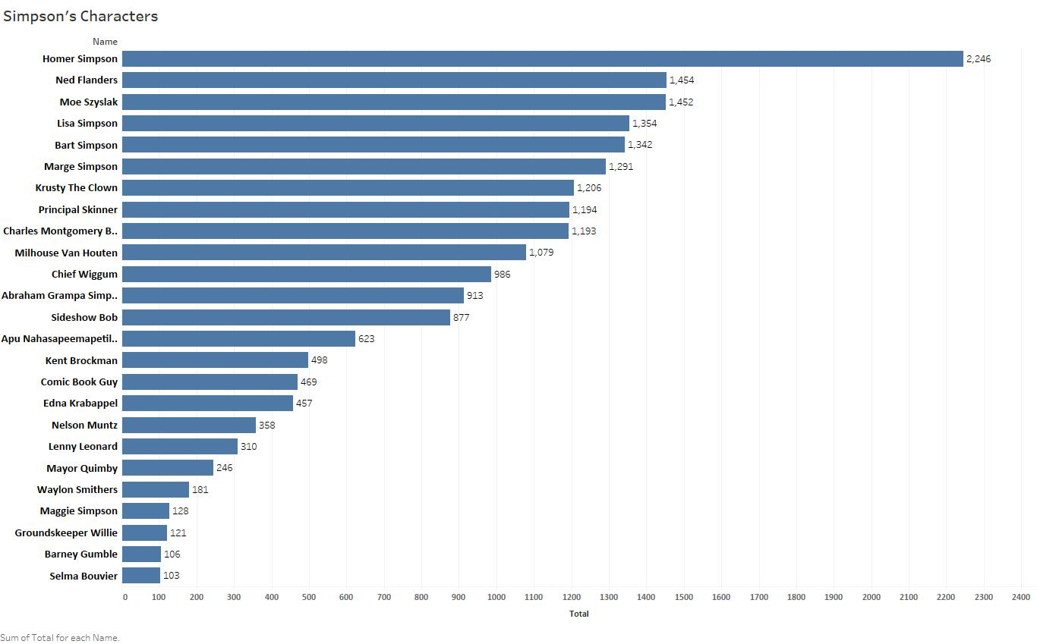
About Data

Slide 11
About Data
Data Quality Assessment
Completeness: (All available data is present)
Characters being classified are when subject image count is greater than 100.
Uniqueness: (No data duplication)
Image set consists of mixed images (as depicted in previous slides). Total count of images make it impossible to visually identify uniqueness.
Accuracy: (Data values stored for an object are the correct values)
Not determinable at this time. This can be determined after algorithms have been executed.
Atomicity: (Lowest level of detail)
Training set contains images that are classified and grouped by character.
Image level annotation to box characters is also provided.
Conformity: (conformity to the defined business requirements and syntax)
The dataset provided conforms to one required to run image classification models.
Overall Quality: Good

Slide 12
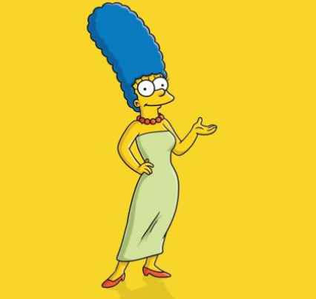
Core Goals & Stretch Goals

Slide 13
SafE Agile – Sprint breakdown

Slide 14

Core Goal 1 - CNN

Slide 15
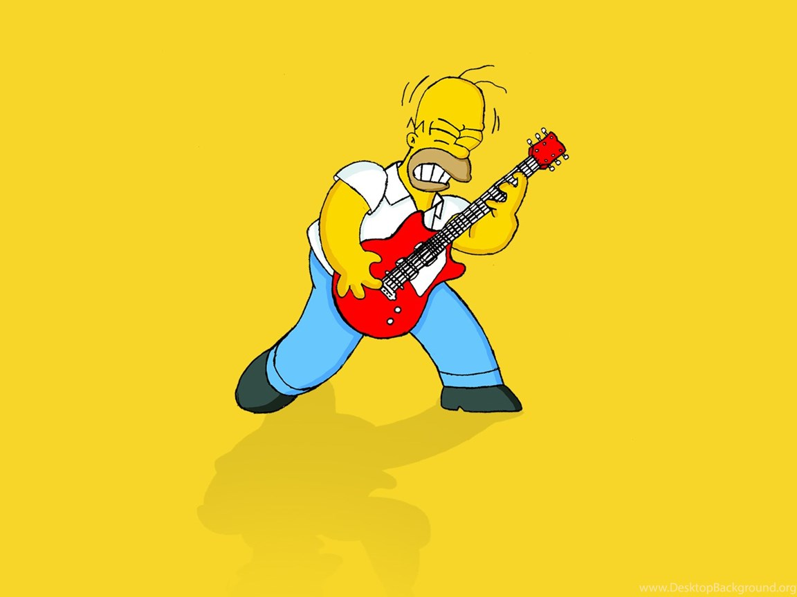
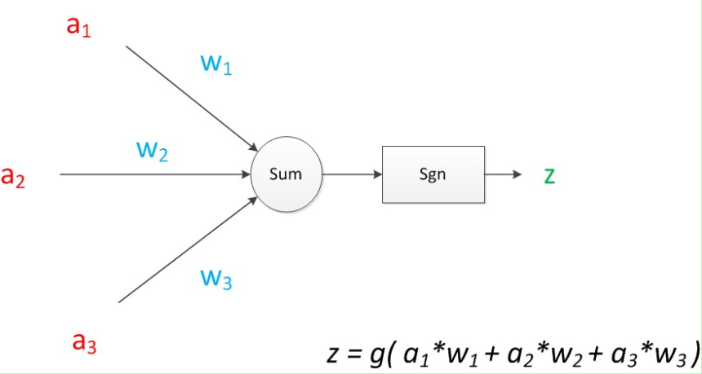
Convolutional Neural Network
A Convolutional Neural Network (CNN) is a multilayer perceptron specially designed for recognizing image contents.
It has three basic layers: Convolutional Layer, Pooling Layer, Flatten Layer & Fully Connected
The CNN sifts through the dataset and classifies each input image into a category. The computer then treats each input image as an array of pixels. According to the image resolution, we can see h * w * d (h = height, w = width, d = size) (Prabhu, 2018).

Slide 16
CNN (In Our Project）
CNN is the basic algorithm for our other algorithms and hence assumes a foundational role in this project. In this project, the CNN is the mastermind behind image classification.
For the deep learning CNN model, each image will go through a series of convolution layers, as well as kernel, pooling and full-connected layers (FC). We can add many convolutional layers and flatten the output into the FC Layer. At last, through an activation function, the results can be output to a class, and the images are classified.
This section had set up 4 convolution layers and we have tried 6 convolution layers.

Slide 17
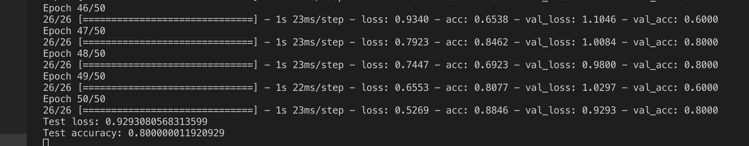
First Result
From ARGO(sample data):

Slide 18
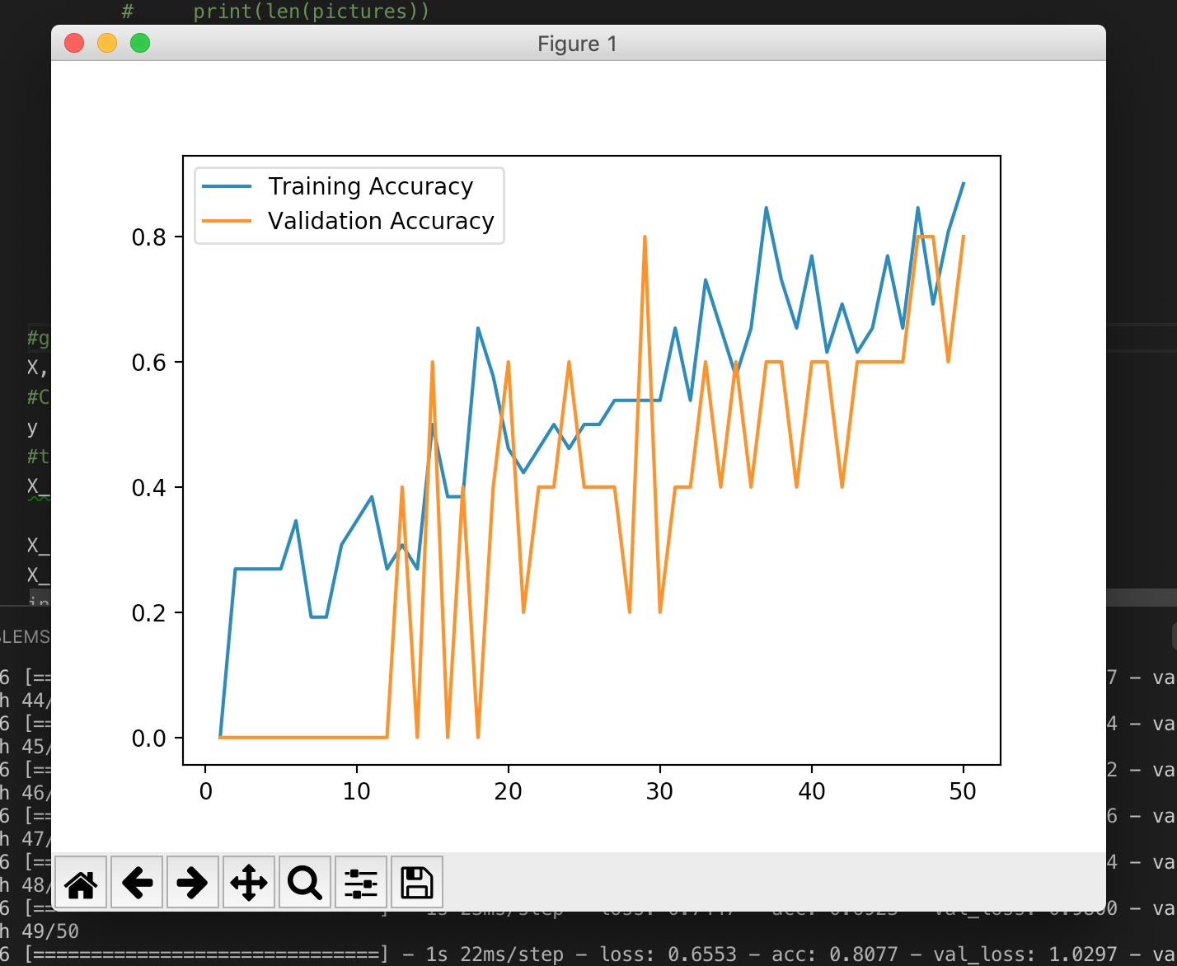
First Result

Slide 19
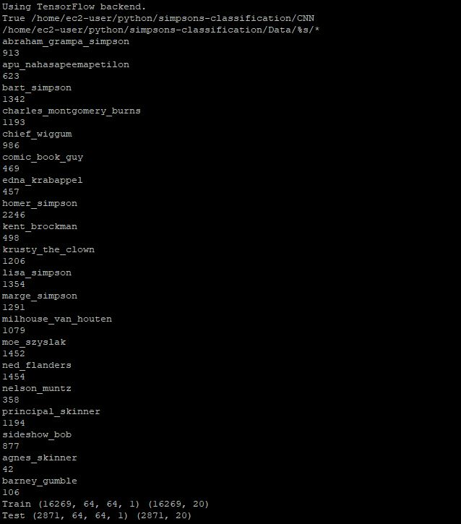
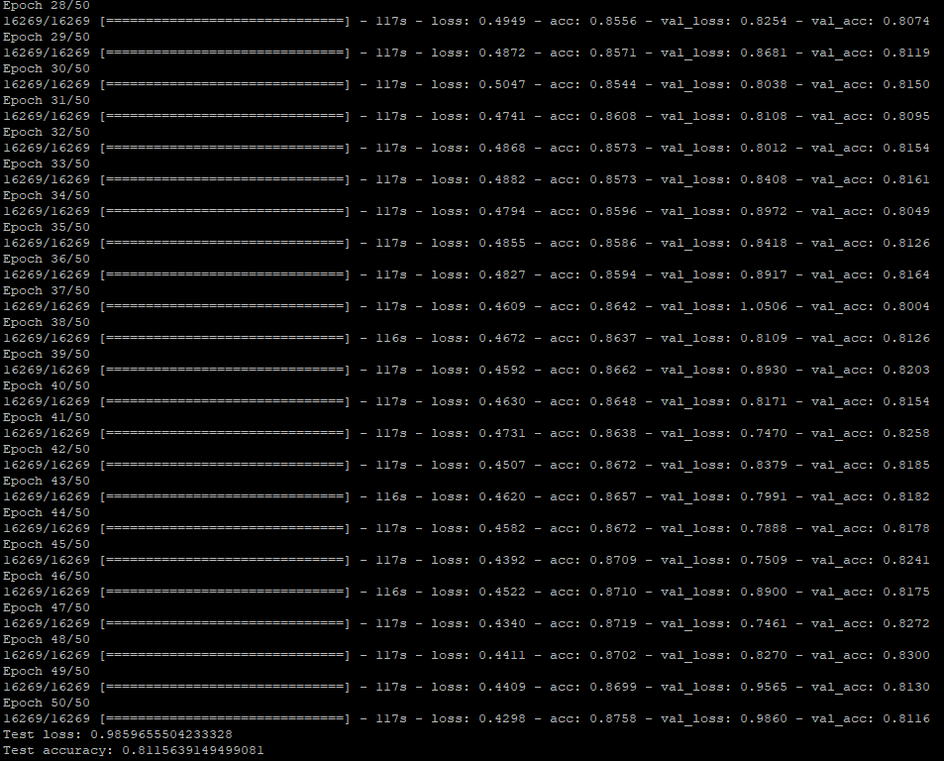
Result on AWS(EC2)

Slide 20
Core Goal 2 - FasterRCNN

Slide 21
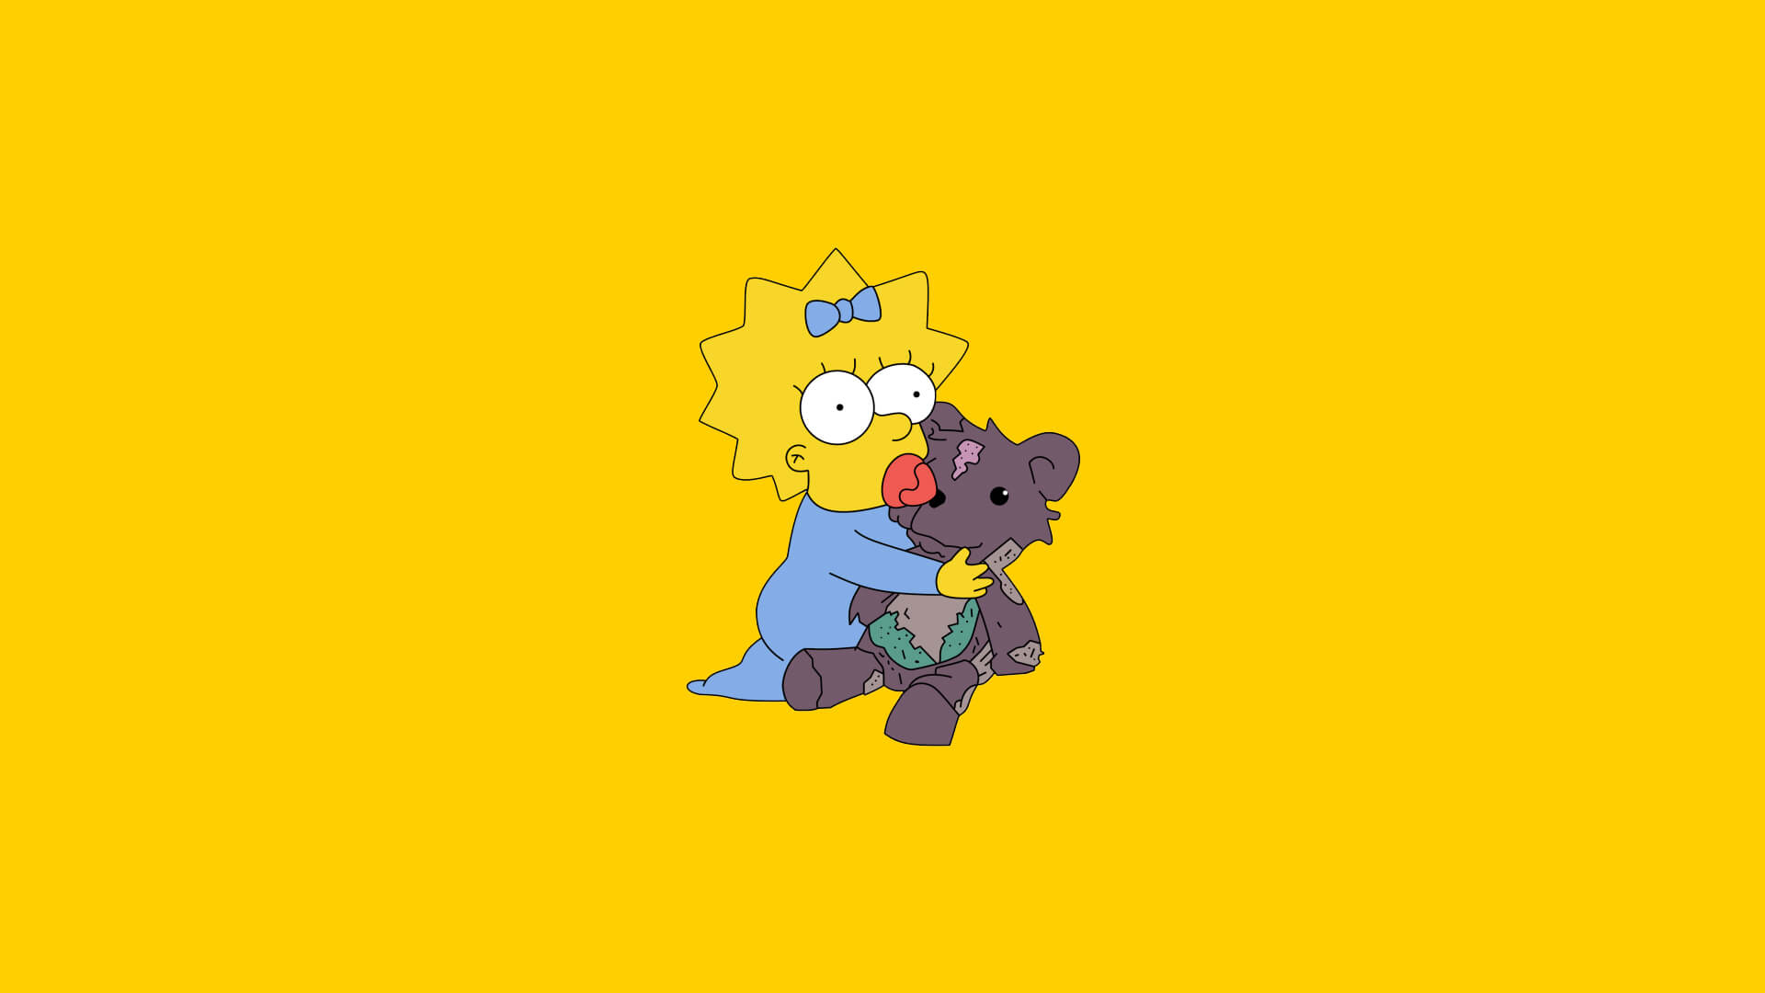

Slide 22
Core Goal 3 - YOLO

Slide 23
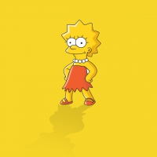
Core Goal 3 - YOLO
Approach taken
Pre-trained model
Training with frozen layer
TensorBoard output

Slide 24
Core Goal 3 - YOLO
Results:
Comparison between models created
Sample images
Sample videos

Slide 25
Core Goal 3 - YOLO
Results:
Why the difference?
Challenges faced?
ARGO experience

Slide 26
Core Goal 4 - SSD

Slide 27
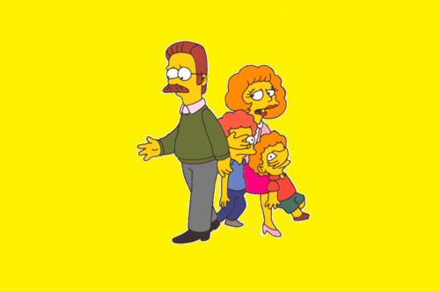
Stretch Goals #1

Slide 28
Stretch Goals #2

Slide 29

Stretch Goals #3

Slide 30
Stretch Goals #4

Slide 31
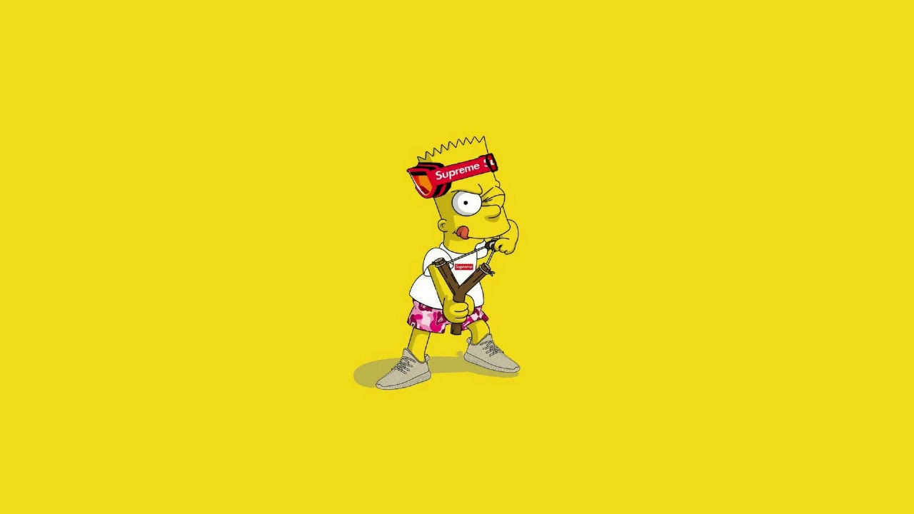
With more time…

Slide 32
Challenges / Learnings

Slide 33
Applications for this concept/research/work
Tad

Slide 34
References
Tad

